Slide 1
END-TO-END LEARNING OF COMPRESSIBLE FEATURES
2020, Nick Johnston et al., Google Research
IEEE ICIP
20201023-魏梓泉

Slide 2
Neural Image Compression for Gigapixel Histopathology Image Analysis
2018, David Tellez et al.
IEEE TPAMI

Slide 3
END-TO-END LEARNING OF COMPRESSIBLE FEATURES
2020, Nick Johnston et al., Google Research
IEEE ICIP2020 (A类)

Slide 4
Contributions
We present a method that jointly optimizes for compressibility as well as the target objective used for learning the features.
We introduce a penalty that enables a tradeoff between compressibility and informativeness of the features. The plug-in nature of our method makes it easy to integrate with any target objective
We demonstrate that our method produces features that are orders of magnitude more compressible in comparison to traditional methods, while having a regularization effect leading to a consistent improvement in accuracy across benchmarks.
Intro → Method → Experiments → Related work → Conclusion → Appendix & Supplemental Material

Slide 5
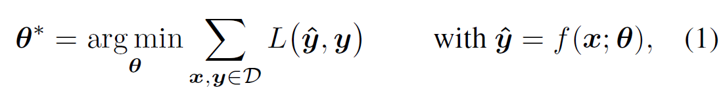
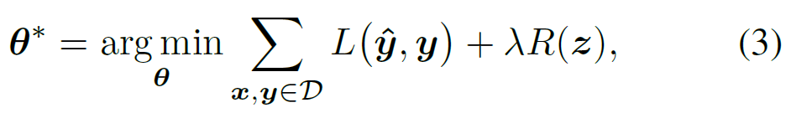
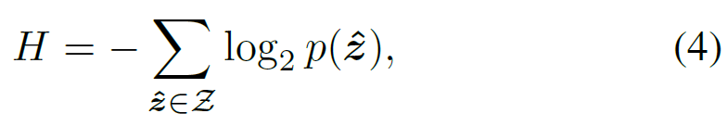

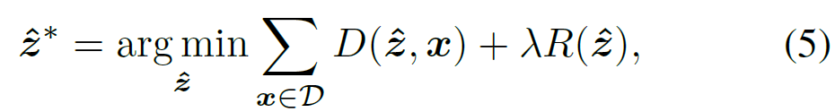
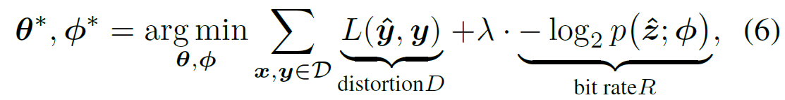
Target Objective & Tradeoff

Slide 6
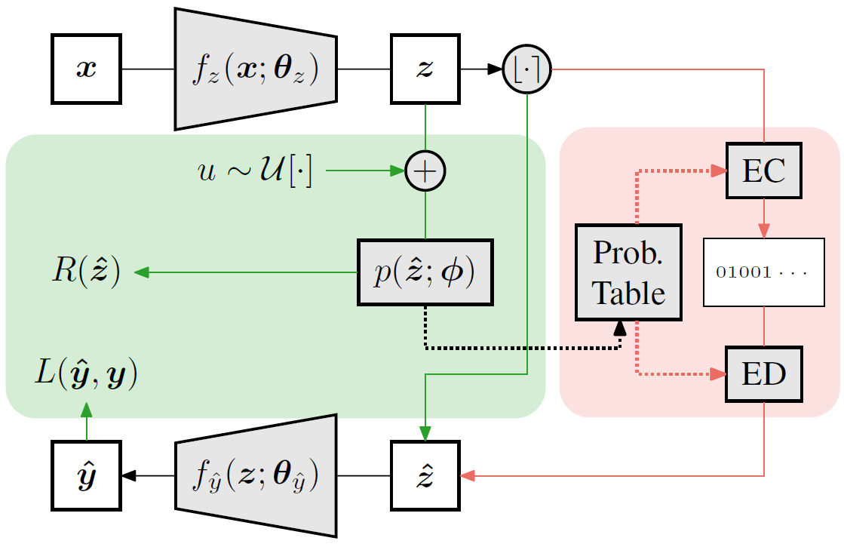
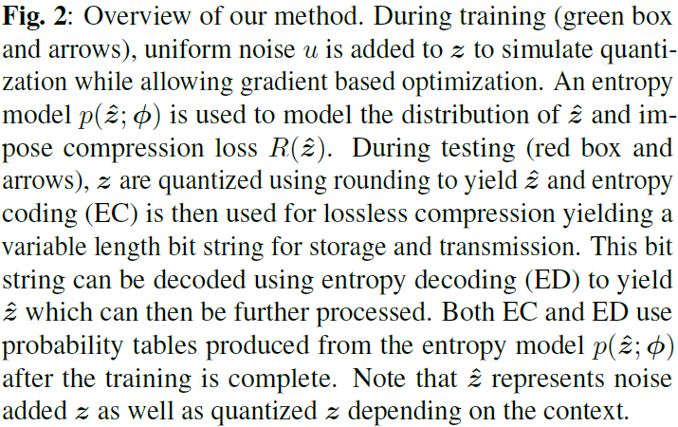
Target Objective & Tradeoff

Slide 7
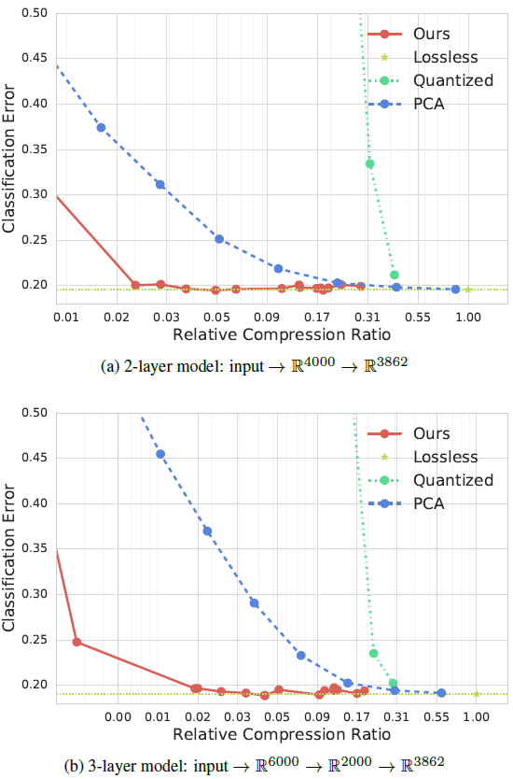
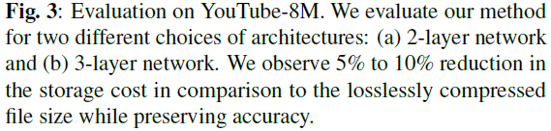
Experiments

Slide 8
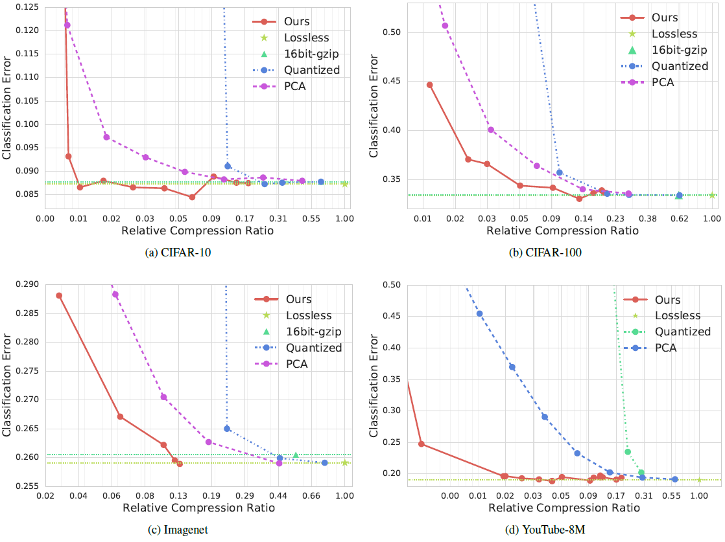
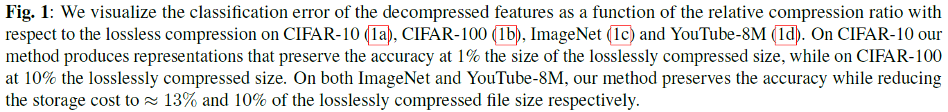

Slide 9
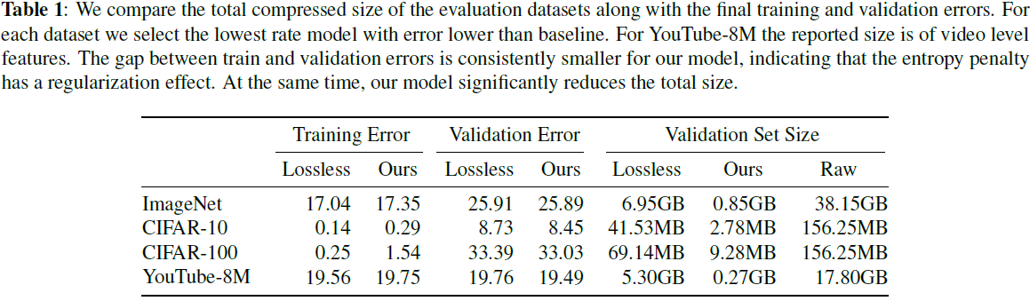
Experiments

Slide 10
Neural Image Compression for Gigapixel Histopathology Image Analysis
2018, David Tellez et al.
IEEE TPAMI (IF 19.420 in 2019)

Slide 11
Contributions
We propose Neural Image Compression (NIC), a method to reduce gigapixel images to highly-compact representations, suitable for training a CNN end-to-end to predict image-level labels using a single GPU and standard deep learning techniques.
We compare several encoding methods that map high-resolution image patches to low-dimensional embedding vectors based on different unsupervised learning techniques.
We evaluate the proposed methodology using two publicly available breast cancer sets of gigapixel WSIs with two types of weak image-level labels.
We generate saliency maps representing the areas of the input gigapixel image where a trained CNN pays the most attention to.

Slide 12
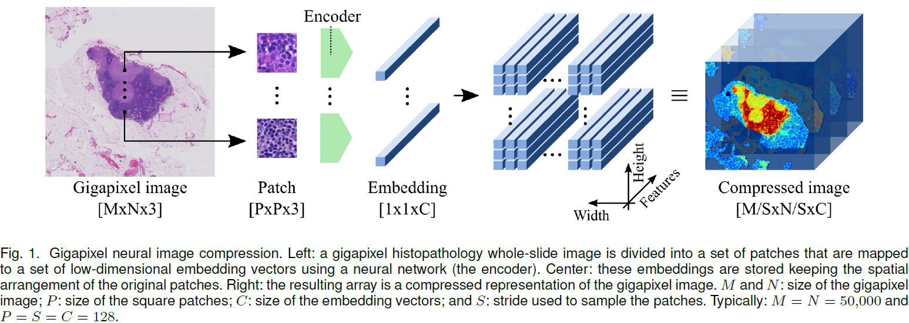
Pipeline

Slide 13
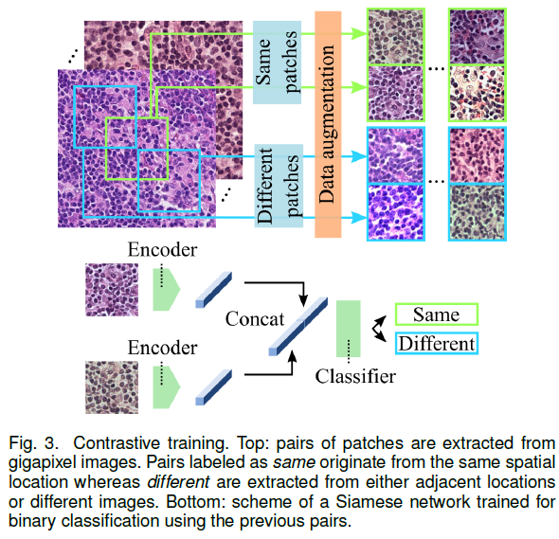
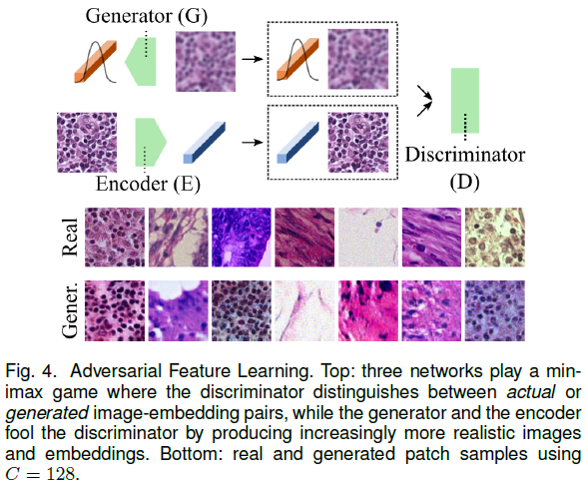
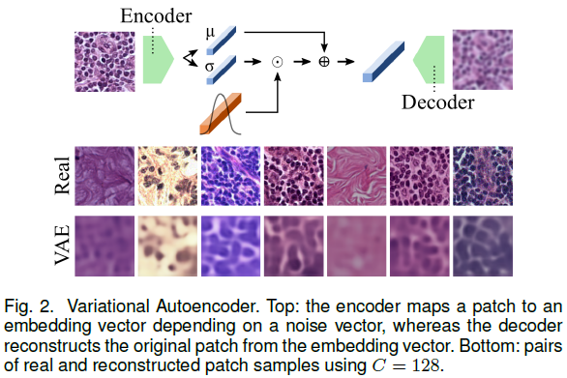
Compression

Slide 14
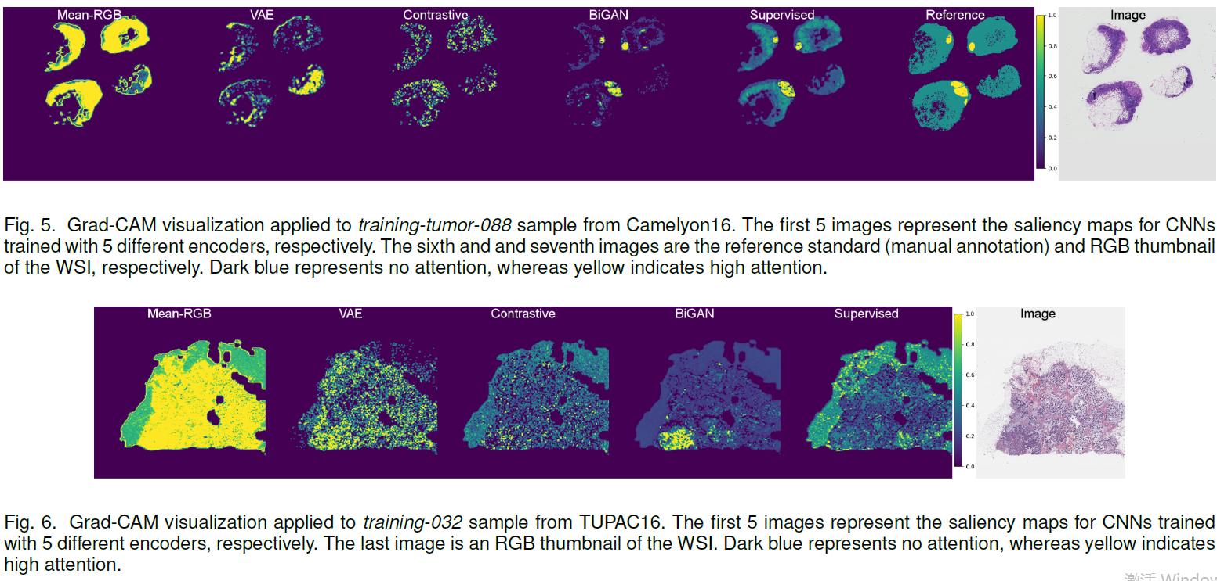
Visualization: Grad-CAM

Slide 15
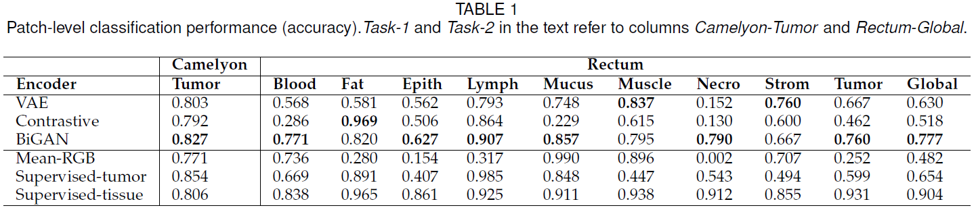
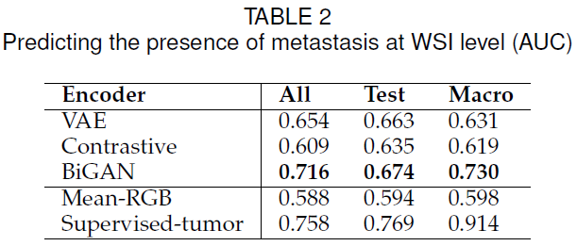
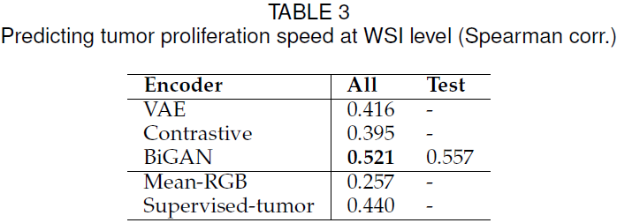
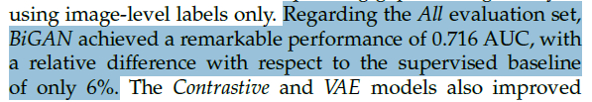
Experiments

